Slide 1
Situation Overview
Transitory short-term issues present an attractive opportunity in a growing and durable retail operator
Investor Concerns
Our View
Inventory Levels: ATZ pre-ordered styles heading into 2023, but shipment came in earlier than expected, creating a a timing mismatch with consumer demand and forcing ATZ to rid excess inventory through significant discounting
Poor Earnings Print: From inventory discounting to significant growth investments, management has struggled to hit margin benchmarks, causing the stock to trade down
Transitory Mishap: We believe the inventory problem should be solved within the next year, as current discounting should not affect the growth story for ATZ
Time Arbitrage: The exact timing of margin recovery is not significant for our long-term view of the company, as we have conviction in the durability of the brand and store expansion plan that will drive revenue and profitability

Slide 2
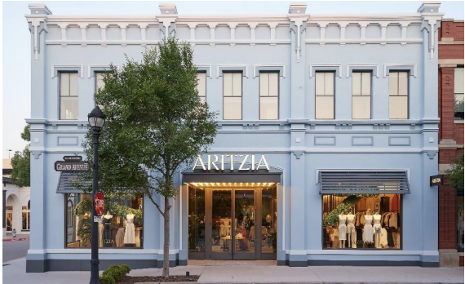
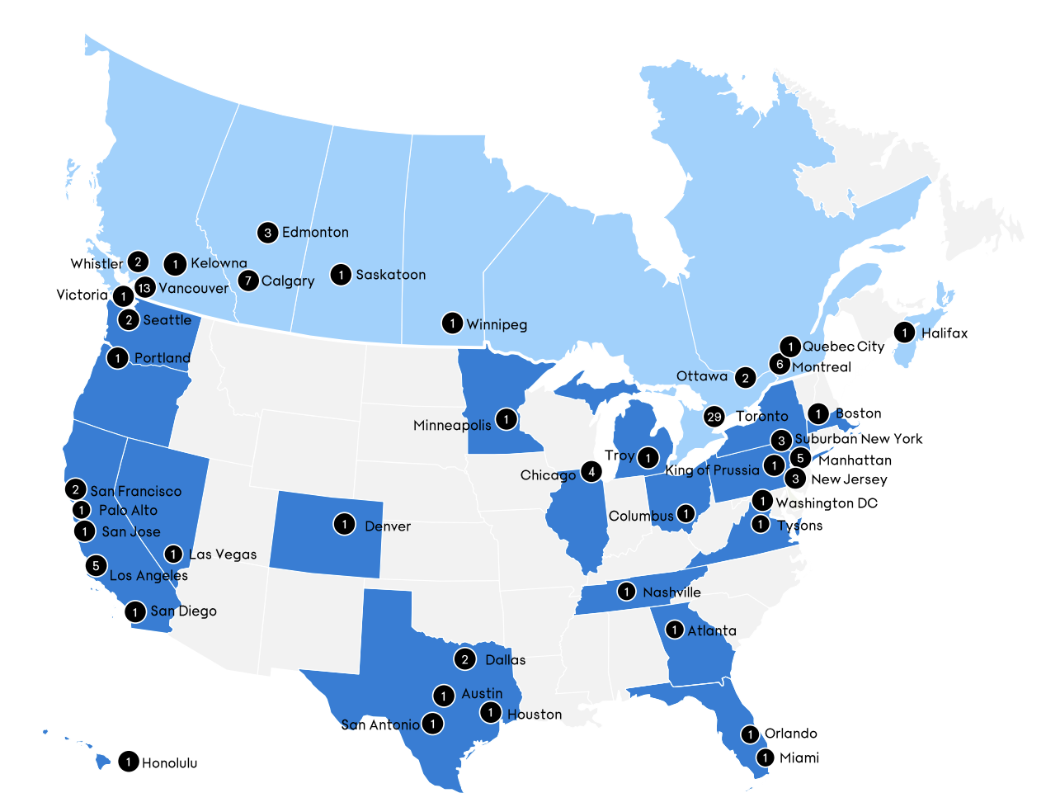
Thesis #2: Clear Paths to Reach Sales Targets
Incremental revenues through expansion in underpenetrated U.S.
US Store Expansion Analysis
Runway
Management estimates that they are currently only 40% penetrated with expansion potential from 46 stores to 100
ATZ guides 7-10 stores per year and should gradually increase market share in $160b U.S. woman’s apparel market
Profitability
U.S. stores price their clothing at the same or higher price points than Canadian stores
Larger U.S. stores enables for greater inventory display and invite higher foot traffic in affluent regions
15.2% growth
Incremental revenue build??
Add something here

Slide 3


Thesis #2: Clear Path to Reach Sales Target
New management should shift focus to building out underdeveloped E-Commerce department
eCommerce Growth Potential
New CEO Will Ignite Strategy Shift
35% of ATZ’s LTM revenue came through online sales, lagging the retail industry average of 45%
  Management guides for longer term digital sales to account for 45% of revenue mix
  Clear runway to improve internal digital operations
Store expansion to catalyze Ecommerce spend as customers prefer to have nearby stores when shopping online
  Opening the first store in a city has driven 2-3x more Google searches for Aritzia
  80% uplift in online sales after 1st store in city is built
Ex-CEO Brian Hill
CEO Jennifer Wong
Founder & CEO of Aritzia for 38 years
Responsible for product and marketing success
Conservative approach to digital mediums
Currently slated as executive chair member
Previous President and COO since 2015
Innovative and driven to enhance eCommerce
Spearheaded digital segment during Covid
Launched the improved eCommerce 2.0 in July
1984 – 2022
2022 – Present

